Slide 1

Network topology

Slide 2

Topology
Topology refers to the layout of connected devices on a network.
Here, some logical layout of topology.
oMesh oStar
oBus
oRing
oTree and Hybrid

Slide 3

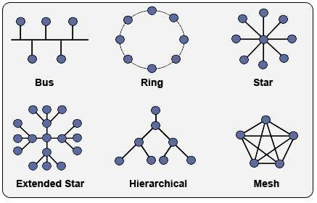
Network Topology

Slide 4

Mesh Topology
Here every device has a point to point link to every other device.
Node 1 node must be connected with n-1 nodes.
A fully connected mesh can have n(n-1)/2 physical channels to link n devices.
It must have n-1 I/O ports.

Slide 5
Mesh Topology
Advantages:
They use dedicated links so each link can only carry its own data load. So traffic problem can be avoided.
It is robust. If any one link get damaged it cannot affect others.
It gives privacy and security.(Message travels along a dedicated link)
Fault identification and fault isolation are easy.

Slide 6
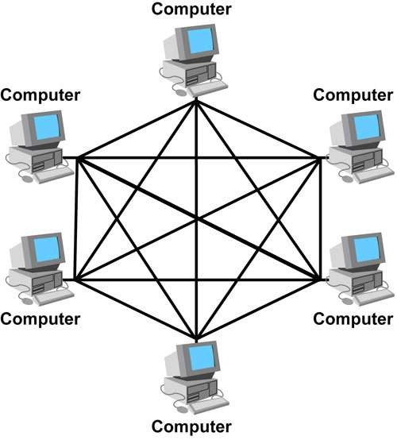
Mesh Topology

Slide 7
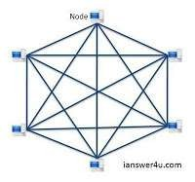
Mesh Topology

Slide 8
Mesh Topology
Disadvantages:
The amount of cabling and the number of I/O ports required are very large as every device is connected to each devices through dedicated links.
The sheer bulk of wiring is larger then the available space.
Hardware required to connected each device is highly expensive.

Slide 9
Mesh Topology
Applications:
Telephone Regional office.
WAN.(Wide Area Network).

Slide 10


Star Topology
Here each device has a dedicated point-to-point link to the central controller called “Hub”(Act as an Exchange).
There is no direct traffic between devices.
The transmissions are occurred only through the central “hub”.
When device 1 wants to send data to device 2; It first sends the data to hub. Which then relays the data to the other connected device.

Slide 11

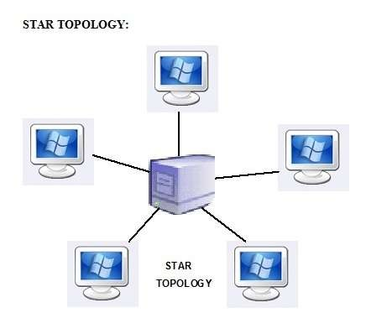
Star Topology

Slide 12
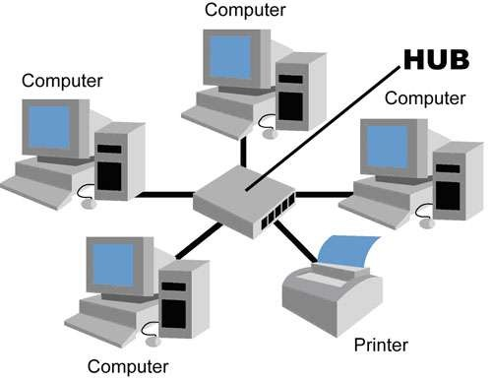
Star Topology

Slide 13
Star Topology
Advantages:
Less expensive then mesh since each device is connected only to the hub.
Installation and configuration are easy.
Less cabling is needed then in mesh.
Robustness.(if one link fails, only that links is affected. All other links remain active)
Easy fault identification & removal of parts.
No distruptions to the network when connecting(or) removing devices.

Slide 14
Star Topology
Disadvantages:
Even though it requires less cabling then mesh when compared with other topologies it is still large.(Ring or bus).
Dependency(whole n/w dependent on one single point(hub). When it goes down. The whole system is dead.

Slide 15

Applications
Used in Local Area Networks(LANs).
High speed LAN often used STAR.

Slide 16

Bus Topology
A bus topology is multipoint.
Here one long cable act as a backbone to link all the devices are connected to the backbone by drop lines and taps.
Drop line- is the connection b/w the devices and the cable.
Tap- is the splitter that cut the main link.
This allows only one device to transmit at a time.

Slide 17

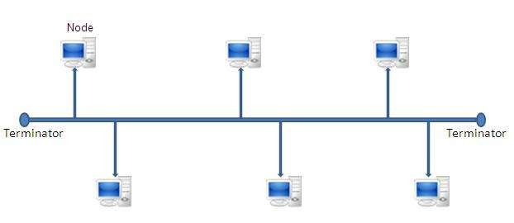
Bus Topology

Slide 18
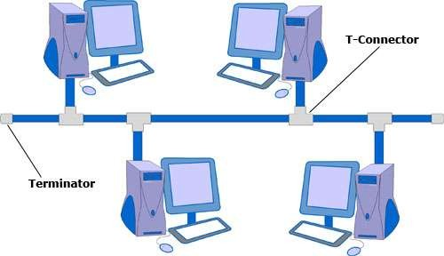
Bus Topology

Slide 19

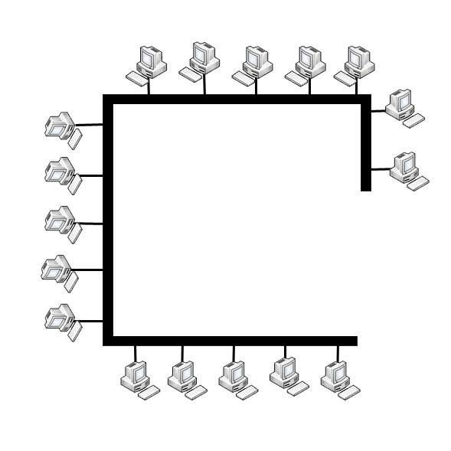
Bus Topology

Slide 20
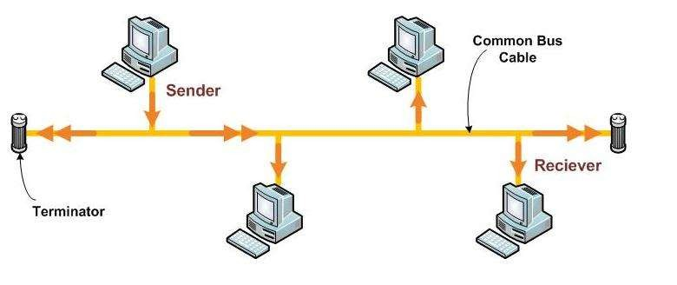
Bus Topology

Slide 21
Bus Topology
When a device wants to communicate with other devices on the n/w, it sends a broadcast message onto the wire for all other devices to see.
But only the intended devices accept and process the message.

Slide 22

Bus Topology
Advantages:
Ease of installation
Less cabling
Disadvantages:
Difficult reconfiguration and fault isolation.
Difficult to add new devices.
Signal reflection at top can introduce degradation in quality.
Any fault in backbone can stop all transmissions.

Slide 23
Bus Topology
Applications:
Most computer motherboards.

Slide 24

Ring Topology
Here each device has a dedicated connection with two devices on either side.
The signal is passed in one direction from device to device until it reaches the destination and each device has a repeater.
When one device receives signals intended for another device, its repeater regenerates the data and passes them along.
Adding or deleting a device requires changing only two connections.

Slide 25

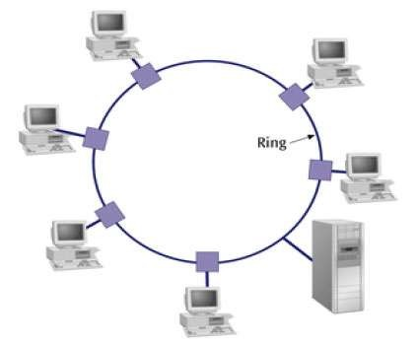
Ring Topology

Slide 26
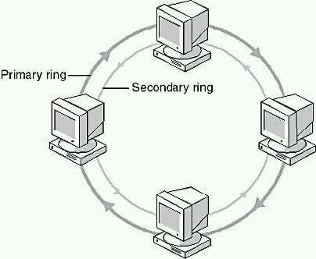
Ring Topology

Slide 27

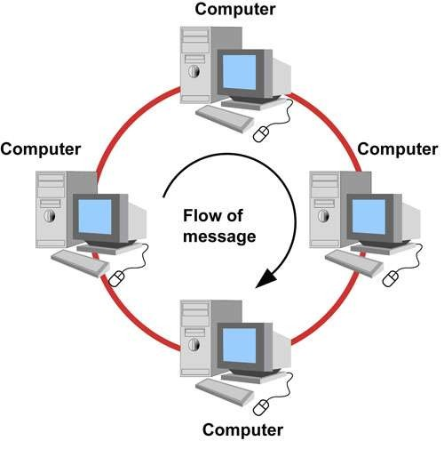
Ring Topology

Slide 28
Ring Topology
Advantages:
Easy to install.
Easy to reconfigure.
Fault identification is easy.
Disadvantages:
Unidirectional traffic.
Break in a single ring can break entire network.

Slide 29
Ring Topology
Applications:
Ring topologies are found in some office buildings or school campuses.
Today high speed LANs made this topology less popular.

Slide 30


Tree Topology
Alternatively referred to as a star bus topology.
Tree topology is one of the most common network setups that is similar to a bus topology and a star topology.
A tree topology connects multiple star networks to other star networks. Below is a visual example of a simple computer setup on a network using the tree topology.

Slide 31
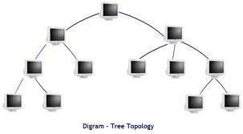
Tree Topology

Slide 32

Hybrid Topology
A network which contains all type of physical structure and connected under a single backbone channel.

Slide 33

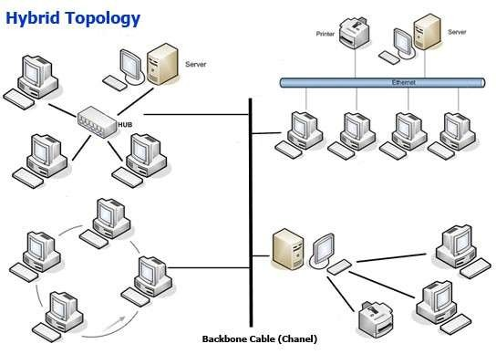
Hybrid Topology
a

Slide 34


Considerations for choosing topology
Money-Bus n/w may be the least expensive way to install a n/w.
Length-of cable needed- the linear bus n/w uses shorter lengths of cable.
Future growth-with star topology, expending a n/w is easily done by adding another devices.
Cable type-most common used cable in commercial
organization is twisted pair. Which is often used with star topologies.

Slide 35
Full mesh topology is theoretically the best since every device is connected to every other device.(thus maximizing speed and security. however, it is quite expensive to install)
Next best would be tree topology, which is basically a connection of star.

